Slide 1


Care of Aging Patients with HIV
MGH Age Positively Program
Virginia Triant MD MPH, Division of Infectious Disease
Matthew Russell MD,MSc, Section of Geriatric Medicine
Massachusetts General Hospital
November 14, 2023

Slide 2
Objectives
To review the demographics of the HIV population and implications for older adults
1
To describe Geriatrics Frameworks
2
To describe the Age Positively Initiative
3

Slide 3
Clinical Case
53 yo right-handed frail (FI=0.32) male with a past medical history of HFpEF (66% in 2/22), Afib on warfarin, prior neurosyphilis c/b CVA with residual right sided weakness and dysarthria, HIV on HAART, BPH, nocturnal enuresis, chronic iron deficiency anemia, h/o methamphetamine use, chronic HCV with cirrhosis, OSA(on CPAP),and recurrent RLE cellulitis. His recent course has been complicated by recurrent falls, the most recent of which resulted in a left patellar fracture treated non-operatively with knee brace

Slide 4
Impact of Aging in HIV
Individuals over age 50 account for approximately half of Americans living with HIV
Older people living with HIV at increased risk for aging-associated complications
  Comorbidities occur at earlier ages: “accelerated aging”
  Geriatric syndromes prevalent
Potential barriers exist to optimal care for this population
  Non-traditional risk factors not reflected in general population guidelines
  Relative lack of experience of specialty infectious diseases providers in aging-related comorbidities and geriatric syndromes

Slide 5
HIV and the Aging Population
63% of people living with HIV are over age 50
35% of persons over the age of 55 with newly diagnosed HIV had stage 3 HIV (CD4<200 or ADC)
  Implication that there is a more limited immune response/CD4 reconstitution among older adults started on ART
Accelerated vs accentuated aging
  Accelerated: Comorbid conditions occur earlier
  Accentuated: Disease occurs at higher rate at every age
Progress has been made…but
  Still an 11-year life expectancy age gap
  Even among those on early ART, an 8-year gap remains

Slide 6
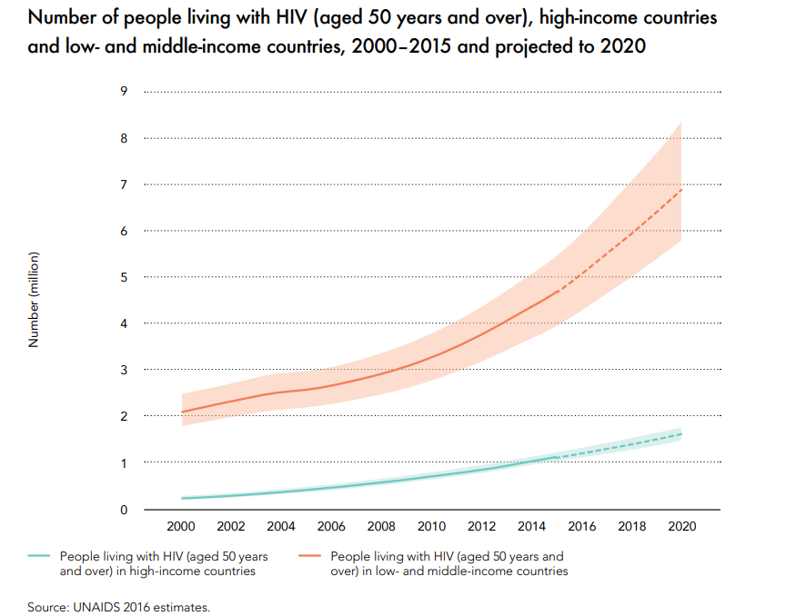
Projected Older PWH by Region
https://www.unaids.org/sites/default/files/media_asset/Get-on-the-Fast-Track_en.pdf
Notes:
Older PWH projected to grow, at faster rate in low and middle income countries

Slide 7
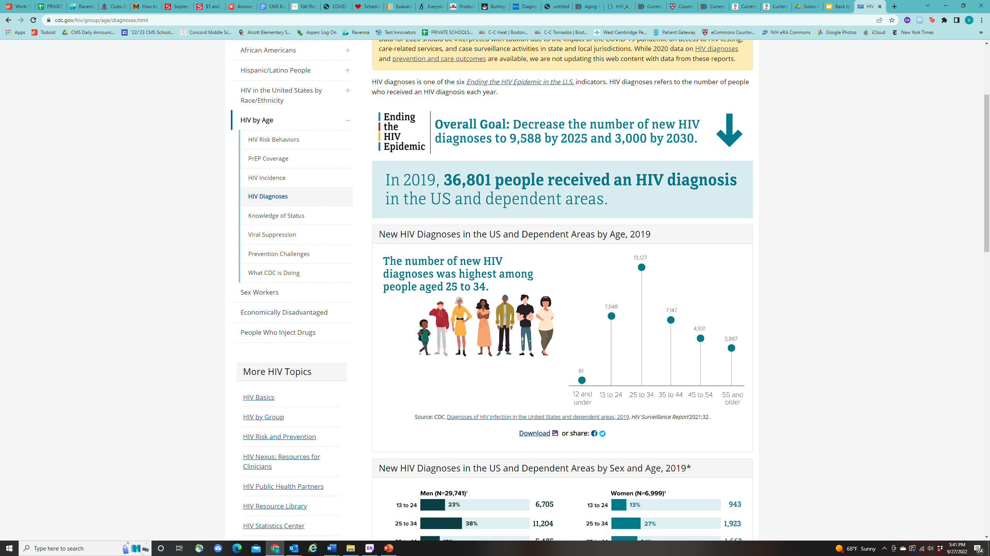
New HIV Diagnoses by Age
https://www.cdc.gov/hiv/group/age/diagnoses.html

Slide 8
HIV and AGING
Comorbidities
Virginia Triant, MD, MPH
Notes:
Jeanne takes over here

Slide 9
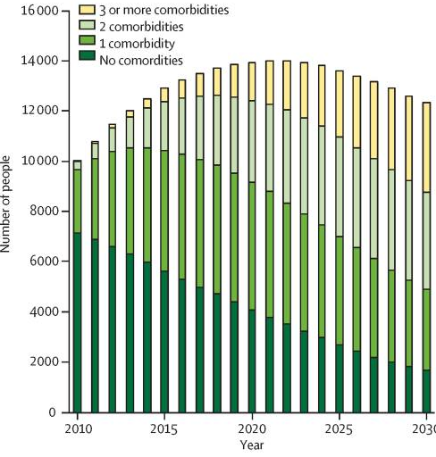
Comorbidities in Aging PWH
Predicted burden of non-communicable diseases (NCDs) in people with HIV (PWH) modeled for 2010-2030
Increasing proportion with more NCDs over time
NCDs include
  Cardiovascular disease (hypertension, hypercholesterolemia, myocardial infarction, stroke)
  Diabetes
  Chronic kidney disease
  Osteoporosis
  Non-AIDS malignancies
Smit Lancet ID 2015.

Slide 10
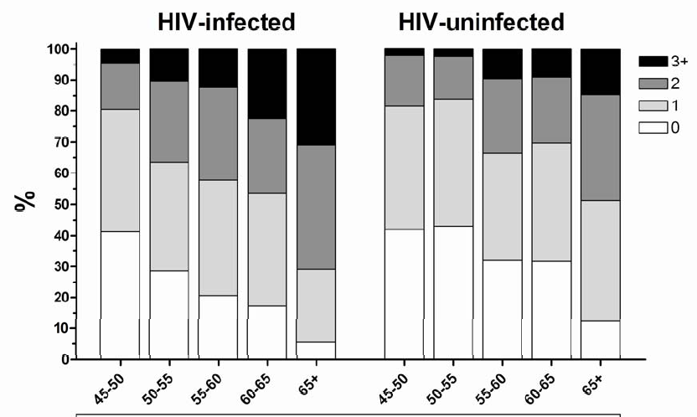
Comorbidities in Aging PWH by Age
Increased NCD rates are not explained by age alone
For a given age group, people with HIV have higher burden of NCDs
  NCDs include HTN, MI, PAD, CVA, angina, DM2, COPD, CKD, non-AIDS cancer, fracture/osteoporosis
Schouten CID 2014.

Slide 11
Impact of Aging in HIV
People over age 50 account for approximately half of Americans living with HIV
Older people living with HIV at increased risk for aging-associated complications
Comorbidities occur at earlier ages: “accelerated aging”
Geriatric syndromes prevalent
Potential barriers exist to optimal care for this population
Non-traditional risk factors not reflected in guidelines
Relative lack of experience of infectious diseases providers in geriatric syndromes
While new HIV diagnoses decreased in other ag groups from 2015-2019, incidence was stable in age 50+

Slide 12
Disparities in CVD Prevention and Management for People Living with HIV
Disparities exist in multiple aspects of CVD risk assessment, prevention, and management in HIV
PWH less likely to receive guideline-concordant CVD preventative care
Less likely to be prescribed statins if eligible
Interventions to prevent CVD have not been tailored to HIV-specific mechanism
Less data available in resource-limited settings
Less data available specifically by sex and race/ethnicity
Relative risk of CVD and role of inflammation relatively greater for women
Recognition as risk-enhancing factor is a step in the right direction
Critical need for HIV-specific CVD prevention approaches and intervention
CVD risk prediction functions underestimate risk in PWH

Slide 13

Challenges Persist
Disparities in prevention and management of aging-associated chronic diseases
PWH less like to receive guideline-concordant preventative care (e.g. less likely to be prescribed statins if eligible)
Lack of HIV-specific guidance
Chronic disease guidelines
Public health policies
Limited access to expertise in geriatric medicine
Notes:
Limited integration of HIV and geriatric medicine programs

Slide 14
Aging and HIV
Matt Russell,MD
Notes:
Matt takes it over here

Slide 15
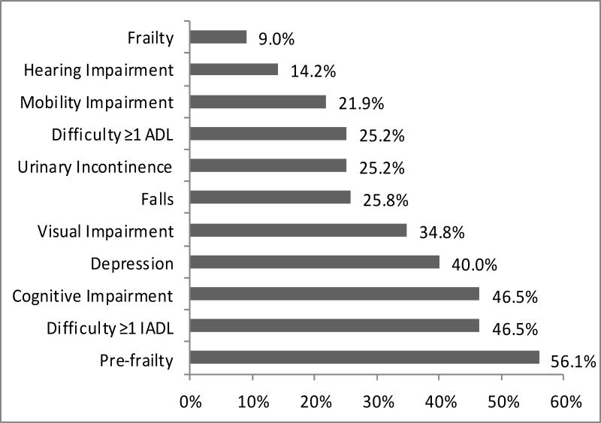
Frequencies of Geriatric Syndromes in HIV
Greene et al. JAIDS 2015
Notes:
We studied 155 participants with a median age of 57 (IQR 54-62); (94%) were men. Pre-frailty (56%), difficulty with instrumental activities of daily living (46%), and cognitive impairment (47%) were the most frequent geriatric syndromes. Lower CD4 nadir (IRR 1.16, 95% CI 1.06-1.26), non-white race (IRR 1.38, 95% CI 1.10-1.74), and increasing number of comorbidities (IRR 1.09, 95%CI 1.03-1.15) were associated with increased risk of having more geriatric syndromes.
We studied 155 participants with a median age of 57 (IQR 54-62); (94%) were men. Pre-frailty (56%), difficulty with instrumental activities of daily living (46%), and cognitive impairment (47%) were the most frequent geriatric syndromes. Lower CD4 nadir (IRR 1.16, 95% CI 1.06-1.26), non-white race (IRR 1.38, 95% CI 1.10-1.74), and increasing number of comorbidities (IRR 1.09, 95%CI 1.03-1.15) were associated with increased risk of having more geriatric syndromes.

Slide 16
Older Adults Living with HIV (OALWH)
Older people living with HIV (PLWH) are at higher risk than their uninfected counterparts
  multimorbidity
  cognitive impairment
  polypharmacy
  depression
  loneliness
  frailty
Siegler, et al. 2018

Slide 17

Stigma
  HIV infection
  sexual orientation
  gender identity
  racism and
  injection drug use
  ageism
Notes:
Older adults with HIV also face significant Stigmata plays a very important role as well.

Slide 18
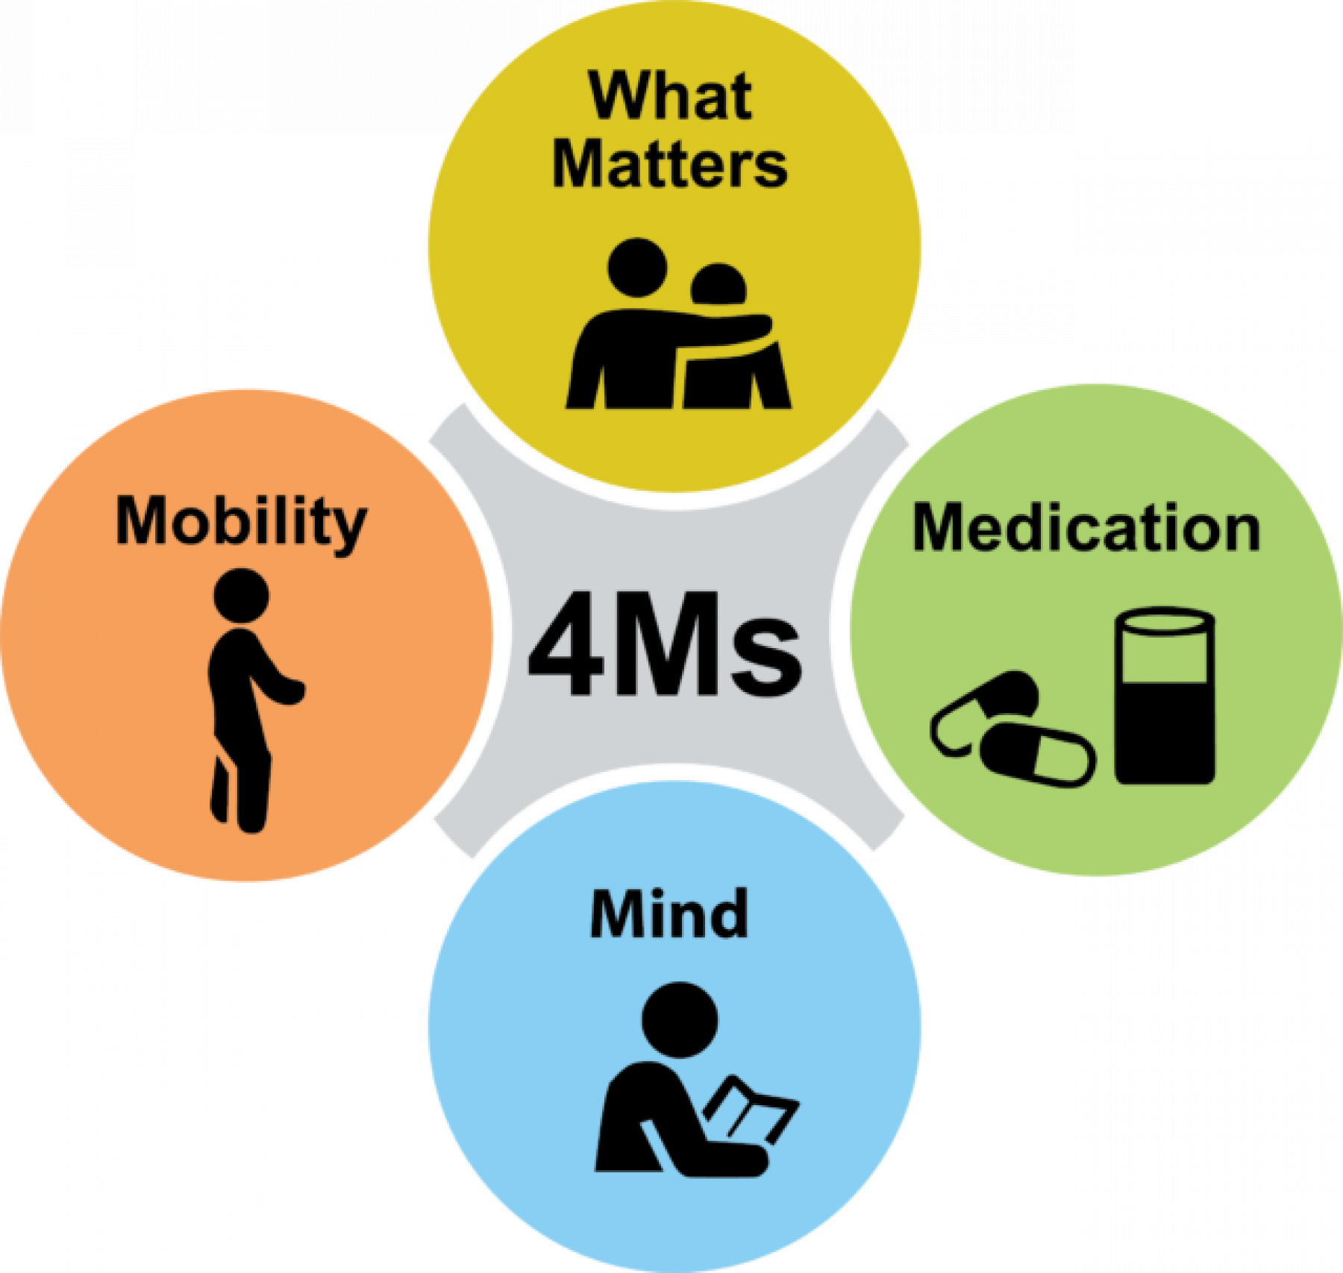

Slide 19
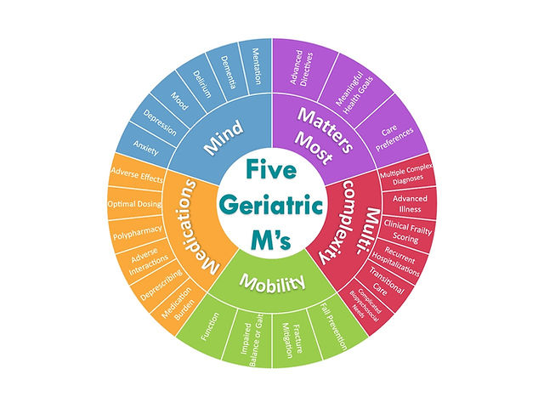
https://www.geriacademy.com: Molnar et al. Can Fam Physician 2019
Notes:
Molnar F, Frank CC. Optimizing geriatric care with the GERIATRIC 5Ms. Can Fam Physician. 2019 Jan;65(1):39. PMID: 30674512; PMCID: PMC6347324.

Slide 20
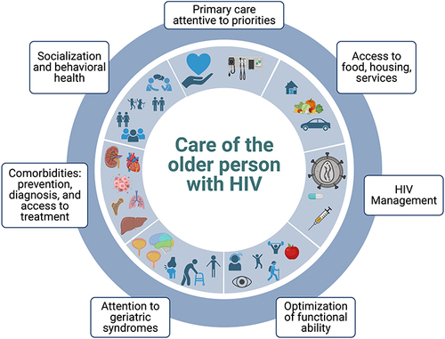
HIV AIDS (Auckl). 2023; 15: 191–208.
Published online 2023 Apr 29. Frey et al.

Slide 21
MGH Age Positively Program
Clinical and Educational Collaboration
Infectious Disease and Geriatric Medicine

Slide 22
MGH Geriatric Medicine Infectious Disease Collaboration:
Age Positively Program
Program Mission Statement
MGH Geriatric Medicine is committed to providing patient-centered clinical care co-management for PWH over the age of 50 with a focus on maximizing physical and cognitive function, reducing unnecessary medications, coordinating complex care, and ensuring that care is provided according to what matters most to the patient. It is our stance that all stakeholders need to feel heard, seen, and respected.

Slide 23

Age Positively Clinical Collaboration
Consultative and co-management
  Capacity dependent
Patients seen in Geriatric Medicine clinic
  Comprehensive Geriatric Assessment (90 minutes)
Q6 month follow up with Geriatrics
  Goal is Q3 month staggering between HIV and Geriatrics providers

Slide 24

The Comprehensive Geriatric Assessment

Slide 25
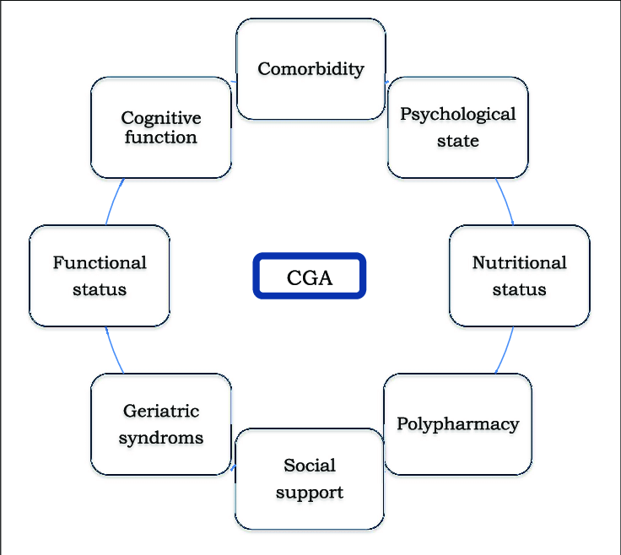
Domains of the CGA
Notes:
Taberna, Miren & Moncayo, Francisco & Jané-Salas, Enric & Antonio Rebollo, Maite & Arribas, Lorena & Vilajosana, Esther & Torres, Elisabet & Mesia, R.. (2020). The Multidisciplinary Team (MDT) Approach and Quality of Care. Frontiers in Oncology. 10. 10.3389/fonc.2020.00085.

Slide 26
CGA Outcomes
Proven
Improved functional ability
Reduced mortality
More probability to live at home after discharge CGA interventions
Unclear
QOL
Caregiver burden
Length of hospital stay

Slide 27
Frailty

Slide 28
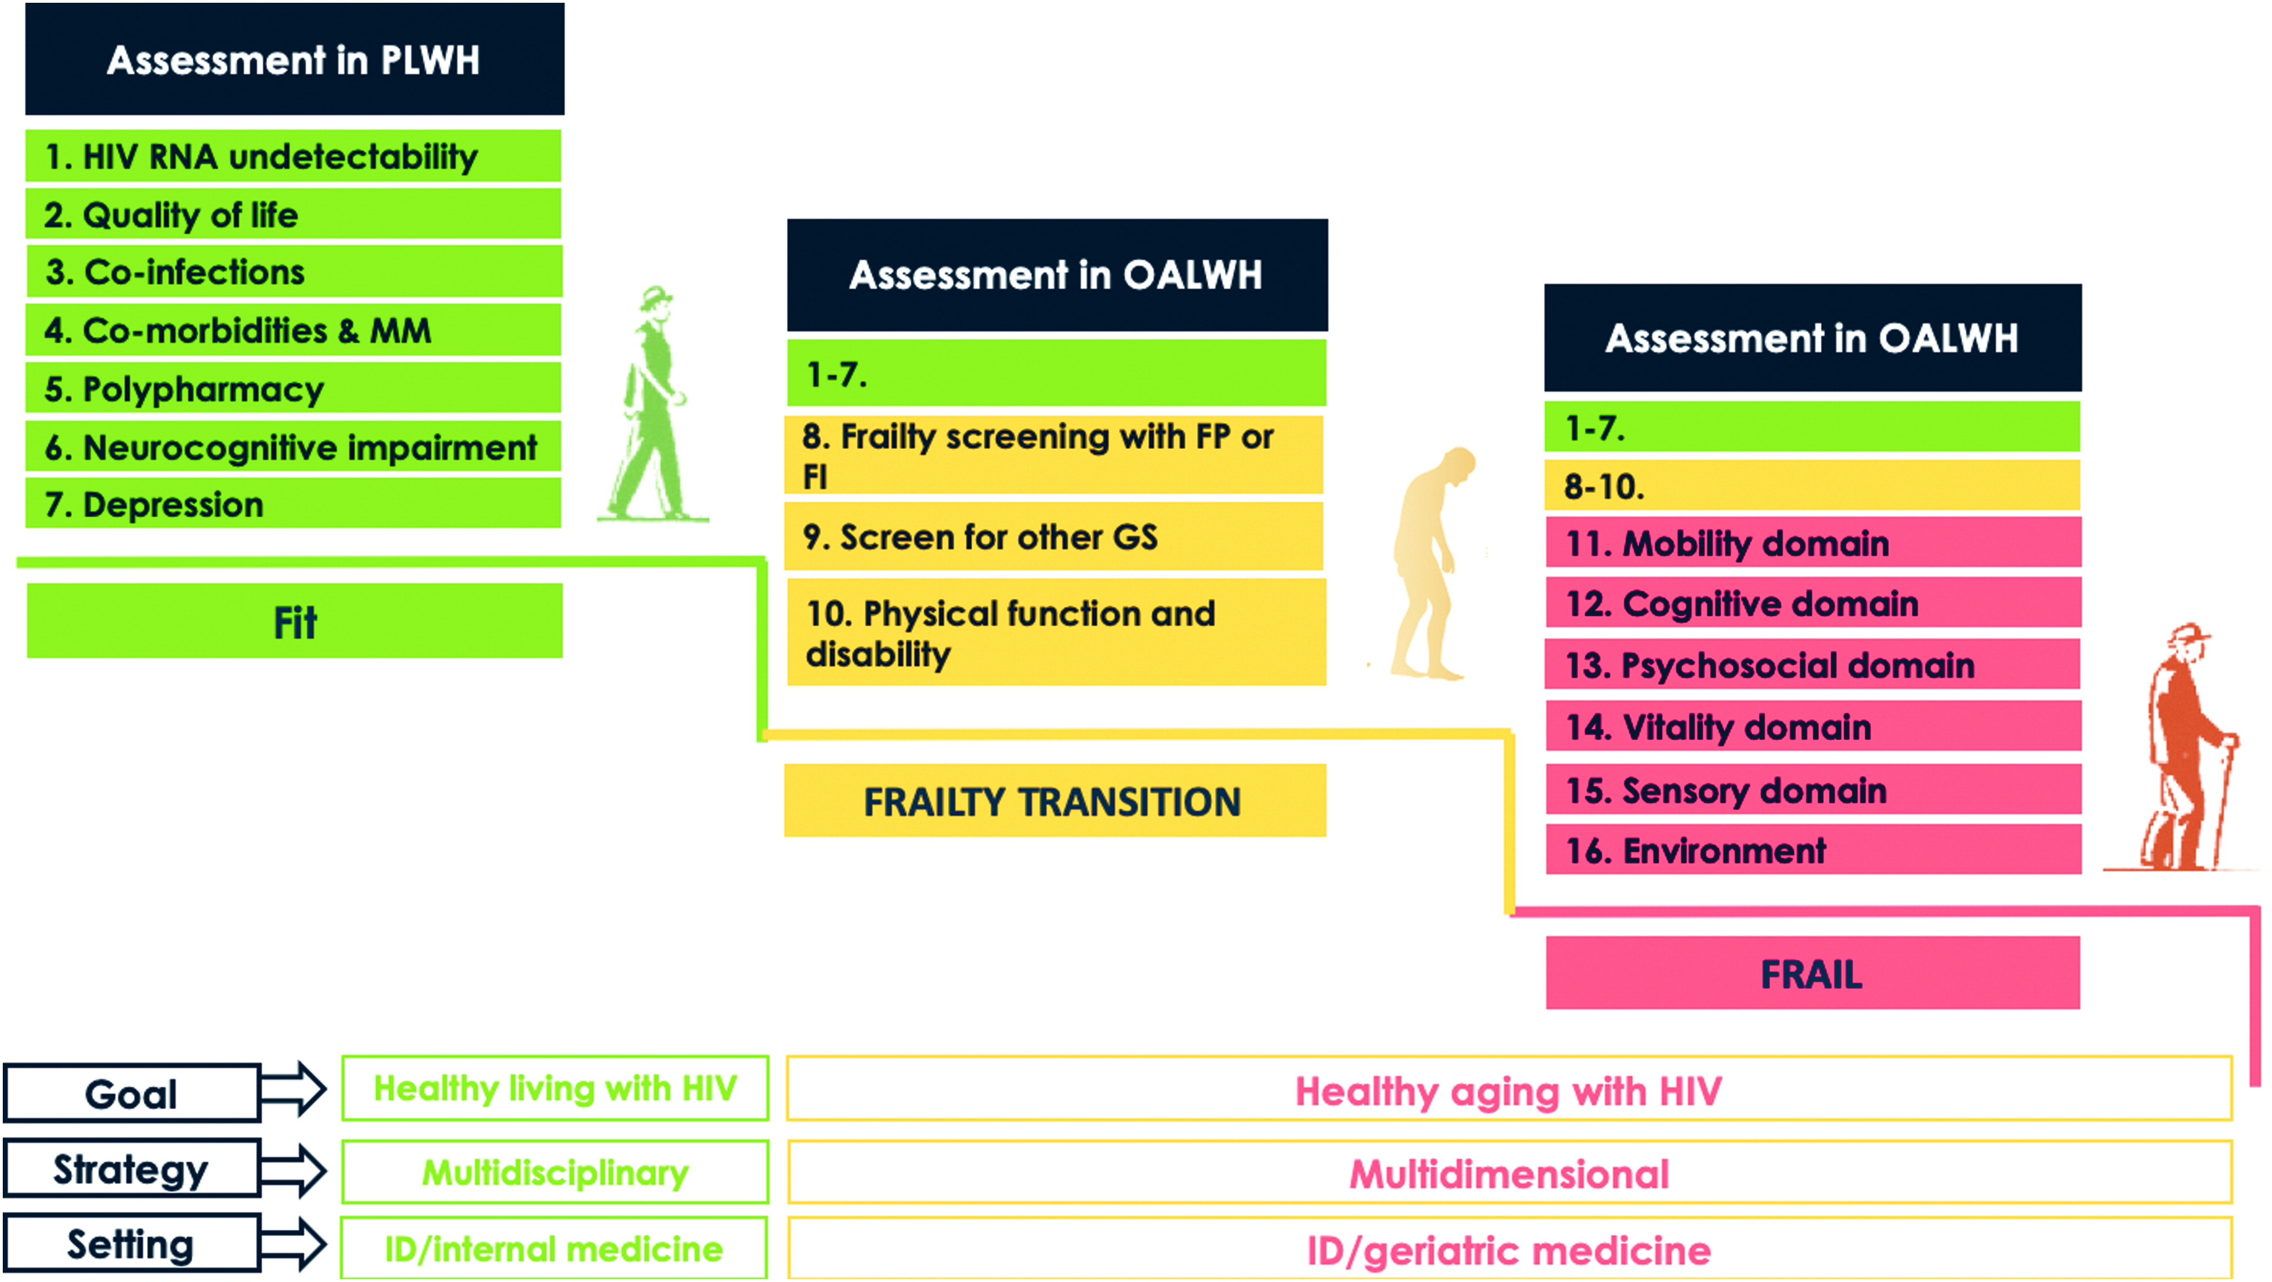
Giovanni Guaraldi and Jovana Milic,2019

Slide 29

Polypharmacy

Slide 30
Polypharmacy
Polypharmacy, often defined as the use of five or more medications, is prevalent in adults ages 65 years and older, with 40% taking 5 to 9 medications and 18% taking 10 or more.
Polypharmacy in PLWH aged >50 ranges from 15-94%
Implicated Medication classes
  CV drugs
  GI agents
  HRT
  Anticoagulant
N Engl J Med. 2011; 365: 2002-2012; Back et al. JIAS 2020

Slide 31
Case continued
Spironolactone
Torsemide
Bethanechol
Venlafaxine
Alfluzosin
Gabapentin
Allopurinol
Warfarin
Mirabegron
Dolutegravir
Darunavir-cobicistat
Rilpivirine

Slide 32
Pharmacist review
Alfuzosin ER 10 mg daily - this interacts with darunavir/cobicistat which can lead to increased concentrations of alfuzosin by 2-3 fold.
ART simplification – Explore resistance history. The patient currently takes three separate tablets for his HIV. Darunavir/cobi 800/150 daily (pretty big pill), dolutegravir 50 mg daily and Rilpivirine 25 mg daily. This regimen includes a boosted protease inhibitor boosted by cobicistat which is a CYP 3A4 enzyme inhibitor and is often implicated in drug-drug interactions.
Assessment of current anticoagulation strategy, he is currently prescribed warfarin for paroxysmal atrial fibrillation and stroke prophylaxis. From a 2021 progress note it was noted that "hematology was consulted for input and they reviewed the case and think he will have to stay with coumadin as there are significant interactions with the darunavir/cobicistat due to CYP3A inhibition and also his weight is 140 Kg (above the usual threshold of 120Kg)

Slide 33
Additional Considerations in HIV
Inappropriate Prescribing
52% up to 69% of elderly PLWH with at least one medication problem
Prescribing issues more commonly non-HIV medications than DDIs with ART
Need for education on Geriatric Medicine Principles
Medication prioritization: hosting the conversation
Risk/benefit
Care goals
Life expectancy
Current functioning
Notes:
There are HIV specific concerns around the risks,impact, and management of polypharmacy. Most notably,

Slide 34
Age Positively…so far
Care coordination challenges
Cognitive impairment
Isolation/Loneliness
Medication interactions/polypharmacy
Frailty
Food Insecurity
Learning difference
Substance abuse
Gait Instability/Falls
Sleep disorders
Palliative Considerations

Slide 35
Growing Pains
Patient awareness
Stigma of becoming “Geriatric”
Referrals
Capacity/Growing Team
Co-management vs. Consultation
Bidirectional Education
  Access to/knowledge of services

Slide 36

Age Positively Town Hall
HIV and Aging Challenge for Urban populations grant
Patient education and outreach platform (zoom based)
Recruitment of speakers and patients

Slide 37
Summary
PWH age with accelerated and accentuated comorbidities and Geriatric Syndromes
Collaboration across disciplines and specialties is key to optimizing care
Expansion of Geriatric conceptual frameworks is needed

Slide 38


Slide 39

Thank You

Slide 40
References
Emily Frey, Carrie D Johnston & Eugenia L Siegler (2023) Treatment Regimens and Care Models for Older Patients Living with HIV: Are We Doing Enough?, HIV/AIDS - Research and Palliative Care, 15:, 191-208, DOI: 10.2147/HIV.S311613
Giovanni Guaraldi and Jovana Milic.The Interplay Between Frailty and Intrinsic Capacity in Aging and HIV Infection.AIDS Research and Human Retroviruses.Nov 2019.1013-1022.http://doi.org/10.1089/aid.2019.0157
Nur F. Önen, Abayomi Agbebi, Enbal Shacham, Kate E. Stamm, Alev R. Önen, E. Turner Overton. Frailty among HIV-infected persons in an urban outpatient care setting,Journal of Infection,Volume 59, Issue 5,2009, Pages 346-352,
Sophia Pathai and others, Is HIV a Model of Accelerated or Accentuated Aging?, The Journals of Gerontology: Series A, Volume 69, Issue 7, July 2014, Pages 833–842, https://doi.org/10.1093/gerona/glt168
Kelly SG, Wu K, Tassiopoulos K, Erlandson KM, Koletar SL, Palella FJ. Frailty Is an Independent Risk Factor for Mortality, Cardiovascular Disease, Bone Disease, and Diabetes Among Aging Adults With Human Immunodeficiency Virus. Clin Infect Dis. 2019 Sep 27;69(8):1370-1376
Siegler EL, Burchett CO, Glesby MJ. Older people with HIV are an essential part of the continuum of HIV care. J Int AIDS Soc. 2018 Oct;21(10):
Nightingale, Sam, et al. "Moving on from HAND: why we need new criteria for cognitive impairment in persons living with human immunodeficiency virus and a proposed way forward." Clinical Infectious Diseases 73.6 (2021): 1113-1118.
Brown TT, Qaqish RB. Antiretroviral therapy and the prevalence of osteopenia and osteoporosis: a meta-analytic review. AIDS. 2006 Nov 14;20(17):2165-74.
McComsey GA, Tebas P, Shane E, Yin MT, Overton ET, Huang JS, Aldrovandi GM, Cardoso SW, Santana JL, Brown TT. Bone disease in HIV infection: a practical review and recommendations for HIV care providers. Clin Infect Dis. 2010 Oct 15;51(8):937-46.

Slide 41
Frailty in OALWH
Baseline frailty was associated with incident cardiovascular disease, diabetes mellitus, and bone disease, while increase in frailty score was associated with mortality.
Incorporation of frailty assessments into the care of PWH may assist in improvement of functional status and risk stratification for age-related chronic diseases.
Kelly et al. 2018

Slide 42
Independent Predictors of Frailty
Independent Predictors of Frailty
  Unemployment
  Greater number of comorbid conditions and past opportunistic illnesses
  Higher depression severity score
  Receipt of antidepressants
  Lower serum albumin.
Hospitalization rates were greater for frail persons with a five-fold longer duration of inpatient stay
Prevalence in PLWH
  Pre-frailty 56%
  Frailty 9%
Onen et al, Journal of Infection 2009
Notes:
This was a prospective cross-sectional study of HIV-infected persons ≥18 years attending Washington University HIV Clinics between June and December 2008. Frailty was defined by ≥3 of 5 criteria: weight loss, low physical activity, exhaustion, weak grip strength and slow walking time. Independent predictors of frailty were evaluated using multivariate logistic regression analyses.
Mean age was 42.

Slide 43
Cognition

Slide 44
HIV-associated Neurocognitive Disorders (HAND)
Up to 50% suffer from cognitive syndromes in the setting of HIV
  More in virally non-suppressed or those with significant comorbidities
  Over-represented in South American and Sub-Saharan African populations
  The majority are asymptomatic
  Most studied in middle-aged or younger participant groups
A recent UK study showed a 3.2% prevalence of cognitive impairment when diagnosed clinically
Aging into traditional decades for AD and other dementias poses diagnostic challenges
Notes:
HIV infection carries it’s own risk for neurocognitive disorders.

Slide 45
Cognitive Impairment
Most HIV guidelines do not make any specific recommendations on screening for cognitive impairment
Screening for cognitive impairment as part of intake and ongoing monitoring is a cornerstone in Geriatric Medical care
Mini-Cog (clock draw and 3-item recall)
MoCA
RUDAS

Slide 46
Mentation
Dementia
Cognitive impairment and related dementias
Depression
Mood disorders
Isolation
Trauma history

Slide 47
Case
CL is a 68 yo male with PMH of HIV (dx in 1986), HTN, HLD, DM seen as part of the Age Positively program. On cognitive testing, he scored a 2/5 on the Mini-Cog which led to performing a MoCA which he scored poorly on 19/30. The examining Geriatrician was quite surprised as the patient was living independently and managing pills and finances expertly. The patient related that he had a very difficult childhood especially in school and that he was ridiculed by his teacher and psychologically and sexually abused at home by multiple family members. He left school as soon as he could.

Slide 48
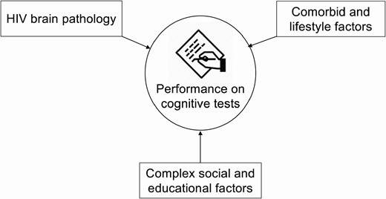
Nightingale et al, 2021

Slide 49
Mechanisms of drug-drug interactions with ART
Can occur at the level of absorption, metabolism, or elimination via the following mechanisms
  Gastric pH changes (antacids)
  Chelation (antacids, cation containing compounds)
  Inhibition/Induction of intestinal cytochrome P450(CYP3A4)
  Inhibition/Induction of hepatic CYP and/or glucuronidation enzymes and/or hepatic transporters
  Inhibition of renal tubular transporters
Notes:
Breeze through this slide

Slide 50
Age Positively Program:
Clinical Consultation
Patients will be referred to the Age Positively program by their MGH/MGB HIV provider using the MGH Geriatrics Ambulatory Consultation order and selecting the “AGE POSITIVE/HIV“ radio button
Any patient of the MGH virology practice ≥50 years of age or on an as-needed basis for a specific aging-related concern or counseling upon request of the provider or patient (cognitive concerns, mobility/home safety, frailty, polypharmacy, etc.) may be referred
PWH >50 will be seen by a geriatrician who will perform comprehensive geriatric assessment during a 90-minute visit with recommendations sent to HIV provider

Slide 51

HIV and Renal Health
Increased risk of AKI
  Protease inhibitors
  Drugs used to treat opportunistic infections
Increased risk of CKD
  Medication nephrotoxicity
  HIV associated nephropathy
  Immune complex kidney disease
  HBV and HCV co-infection
https://www.uptodate.com/contents/overview-of-kidney-disease-in-patients-with-hiv#H15534534
Notes:
HIV infection is associated both with acute and chronic kidney disease. Some protease inhibitors and drugs used to treat opportunistic infections are associated with AKI. But there is also an increased risk of CKD through a variety of mechanisms including medication nephrotoxicity, HIV associated nephropathy, Immune complex deposition disease and HBV and HCV coinfection

Slide 52
Bone Health
The overall estimated prevalence in people living with HIV and 25(OH)D deficiency is high, ranging from 70.3 to 83.7%
The prevalence of osteoporosis in HIV-infected individuals is more than three times greater compared with HIV-uninfected controls.
ART-exposed and PI-exposed individuals had a higher prevalence of reduced BMD and osteoporosis compared with their respective controls.
Male hypogonadism in PWH
HCV/HIV coinfection
Brown et al. 2006

Slide 53
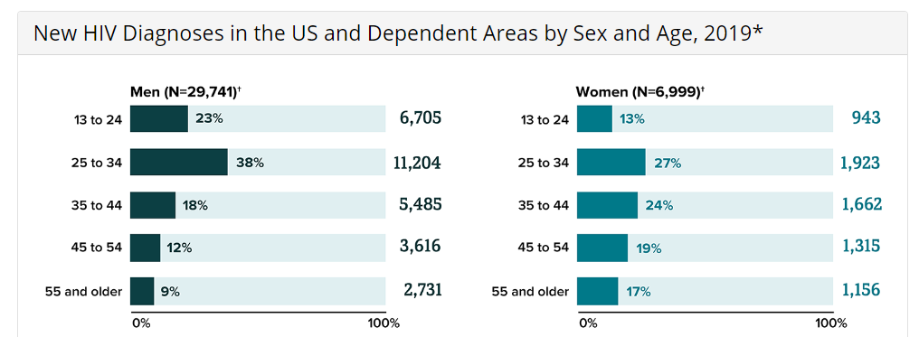
New HIV Diagnoses by Age and Sex
https://www.cdc.gov/hiv/group/age/diagnoses.html

